Slide 1
2024 Wing Information Session & Town Hall
SQNLDR Ben Cowan

Slide 2
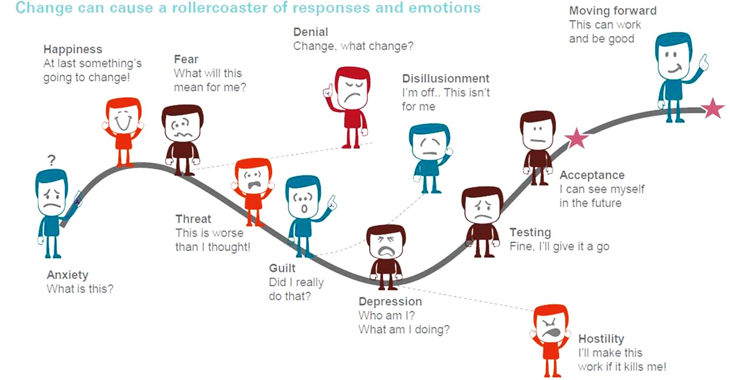
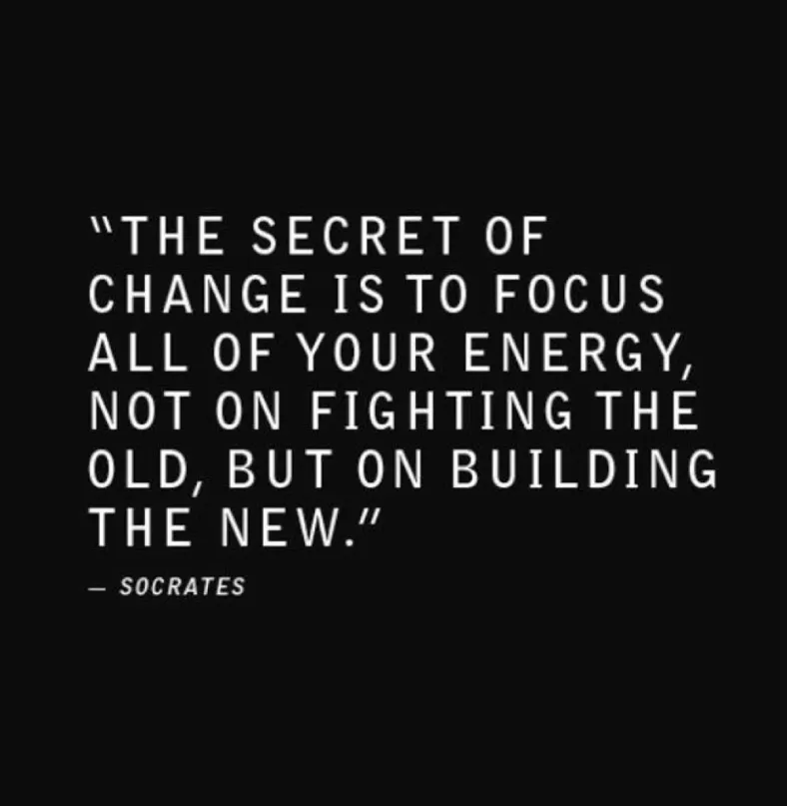
Change
Change can cause a rollercoaster of responses and emotions

Slide 3
Cadet Program

Slide 11
DAC / Field Skills / Aviation Gold
Drill and Ceremonial
SLR immersion - Fed Guard
Drill comp -design, delivery and potentially organisation of
Precision drill team - lead and perform
Band badge counts
Field Skills
Drill and Ceremonial
Aviation
Pilot Solo badge
RPAS license
Gliding
How can aviation be exciting and engaging
Build a flying machine
Aircraft mechanic
Individual Project
Air Power Centre - learning
Recording of Air and Space conference
Field Skills
Adventure Training Badge - SI, limited spaces
Individual Survival attached to a BIV - air force combat survival
Air and Space Power
AND/OR
AND/OR
AND/OR
AND/OR
AND/OR
AND/OR
AND/OR
AND/OR
Notes:
Topics – NEW OPPORTUNITY
Print bronze and silver field skills Los
Print off Adv Trg SI
Aviation: what can Cadets achieve that is practical

Slide 12
Notes:
What is Positive Youth Development (PYD)?
A theoretical, evidence-based approach to conceptualising healthy and productive youth development. PYD is both rooted in the theoretical traditions of developmental psychology, and fuelled by newer emphases on nurturing the potentialities of youth more than addressing their supposed deficits
A structured process aimed toward both guiding youth through the challenges of adolescence and preparing them to the transition into adult life
A philosophical view that recognises the important role of:
developmental contexts in shaping values and identity
youth themselves as agents of their own development
The Six C’s
The 6Cs framework is a globally-recognised framework for implementing positive youth development. The framework ensures the AAFC program will be focusing not on ‘fixing’ cadets behaviour but shaping, building, and nurturing their beliefs, behaviours, knowledge, attributes and skills.
The pro-social approach to the program engages cadets within their communities, schools, organisations, peer groups and AAFC adults in a manner that is productive and constructive to their development.
A framework to assist in preparing young people for community life through fostering healthy exploration of physical, cognitive and development.
Emphasis on continual feedback loops with their networks to help them be productive, connect positively with others, navigate challenges and become self-sufficient emerging adults.
The PDL framework acts as a cohesive thread that runs through all learning and cadets will be challenged to grow these qualities year on year.

Slide 14
PDL Framework

Slide 16
Senior Cadet – Foundation Missions
Focus: to provide senior cadets with a worthwhile learning opportunity
Senior Missions will seek to stretch the cadets, to enable them to apply and deepen the leadership skills and personal development they have learned and undertaken during their time with the AAFC
Senior Missions will require the Cadets to demonstrate innovation: they will be asked to step outside their comfort zone to plan and execute the missions on subject matter or using activities different to those they have experienced earlier in their AAFC time
Offered over years 4-6
Missions (x5) approx. 10 hrs
Flexibility on completion (max 12 months)
Self-led/directed with some theory but mainly practical based
Allow for flexible cadet attendance
Youth Development
Facilitator / Instructor
Learning
SQN Role
Notes:
Get out what they put in
Not outcome driven
Have some PDE nights where there is engagement between cadets and staff – so requires programming, but also requires flexibility
Cadets could do the same mission multiple times – eg 2 lots of work experience OR RSPCA one year and the cancer council next year
Programming guidance around senior phase missions

Slide 17
Senior Mission 1 - 2
1 (Defence) | 2 (Outreach)
Purpose: enable the Cadet to explore the reality of working within the ADF, focusing on the roles and people elements | Purpose: enable the Cadet to deliver a benefit to the community
Focus is on Defence roles not platforms and extends across the ADF and Department of Defence Mission to provide exposure to Joint opportunities and could include work experience Mission could include a physical component, for example attaining initial Defence recruiting fitness standards SQN support could include assistance with resume writing, interview preparation, and presentation advice | Meaningful contribution to the community (others) - makes a difference Emphasis is on giving time rather than raising money
Outputs: Resume and reference | Outputs: Planning and coordination of activity

Slide 18
Senior Mission 3 - 4
3 (Entrepreneur) | 4 (Leadership)
Purpose: provide the Cadet with career exposure to opportunities outside of Defence by enabling them to explore the reality of working within the broadly defined air and space community | Purpose: enable the Cadet to clearly define and build their leadership style and brand
Mission will use a non-Defence (Mission One), non-community engagement (Mission Two). This includes industry broadly (not limited to Defence Industry) with some tie to air and space, such as STEM, emergency services, or trades Mission will require the Cadet to complete research to determine what they will try, then to prepare a resume and cover letter, and develop interview skills AAFC Foundation linkage is key to providing opportunities across Defence industry | Mission will ask the Cadet to understand and define who they are a s a leader. It may use tools such as Myers Briggs of the SDI to help them understand themselves and to select what characteristics they wish to strengthen or explore Leadership could be explored through working with local government, completing an Adventure Training Badge, completing a Cert IV in Frontline management, or through a modified Exercise Green Eagle. Mission will be framed around leadership qualities with a strong focus on decision making, conflict resolution, problem solving and diversity of thinking.
Outputs: resume and reference | Outputs: Cadet defined leadership brand

Slide 19
Senior Mission 5
5 (Transition – to adult volunteer)
Purpose: enable the Cadet to understand the nature of the transition from the role of Cadet to the role of adult volunteer, focusing on the changes to responsibility, behaviour and relationships, as well as building some of the skills they will need in the early days of volunteering
Mission will enable the Cadet to build awareness and understanding of the change of thinking the change of role will require. It will be allow the Cadet to determine what they need to do to prepare themselves. Mission will incorporate a strong sense of self-reflection. It will ask the Cadet to consider: challenges that are likely to arise and strategies to apply when they do what it means to be a volunteer what kind of volunteer they want to be Skills and knowledge built will include delivering on cadet program, specifically leading those to whom they are close in age
Outputs: commencing the onboarding process, including becoming part of the Buddy system

Slide 20
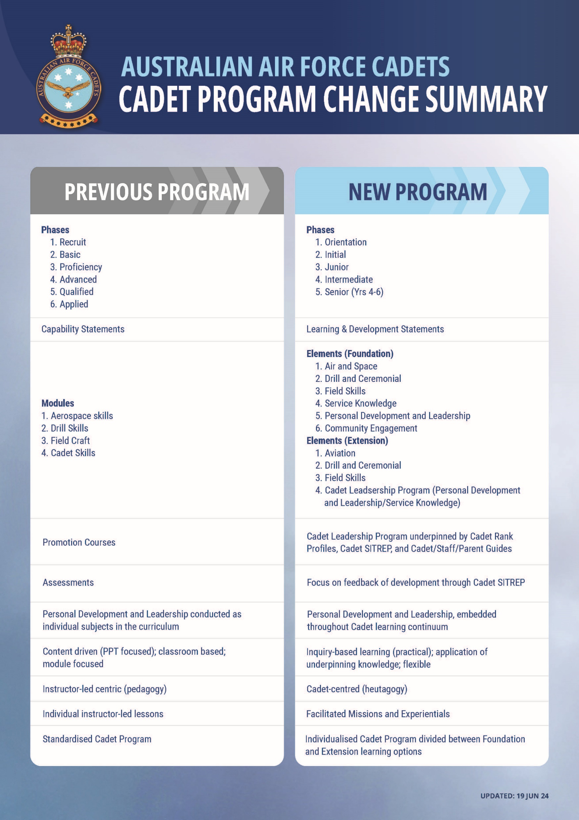

Slide 21
Adult Program

Slide 22
Adult Program
Notes:
The intent of the Adult Program –
The AAFC actively promotes the learning of adult volunteers to fulfil their roles, to best enable them to deliver the desired experience for the cadets, and to enable their performance and personal growth. Adult volunteer involvement with the AAFC is designed against five principles:
• Leadership at all levels. All adults model and promote AAFC leadership qualities for cadets and other adults.
• Learning supports AAFC resilience and agility. The Adult Program supports efficient onboarding, underpins capability development across the AAFC that is scalable, and helps build community within the organisation.
• Valuing the adults. Personal and Professional Growth (PPG) instils appreciation of adults’ vital role in delivering the cadet program and meeting AAFC’s mission and aims.
• A strong and distinct AAFC community. The Adult Program learning ecosystem fuels a sense of belonging to the AAFC, built around shared passions for youth development, as well as interest in the RAAF and the air and space environment.
• Skill and knowledge utilisation. The incoming skills of adults are leveraged, and AAFC learning and development is transferable to contexts outside AAFC.
How learning is delivered across The Adult Program -
The learning delivered through the Adult Program is a collection of smaller programs based around three key streams: organisational understanding, roles and functions, and leadership. Each of these streams is aimed at ensuring adults have access to the right information at the right time, with the right behavioural and values-based guides and information.
The approach taken by the Adult Program acknowledges and reflects changes in society and considers the learning needs, experiences, and expectations of learners as individuals. It embraces leading-edge methods and development in learning theory and embraces new technology. The curriculum delivers a personalised experience that understands different learning styles and adapts to those different characteristics. Learners are helped to absorb knowledge and experience in a meaningful and applied way.
As an OC/ CO how can you support?
- Do you have a good understanding of the buddy and mentor framework or do you need additional support?

Slide 23
The Adult Program Learning Ecosystem
The Adult Program drives to deliver learning using the 70-20-10 learning model.
10
20
70
Formal Learning
Buddy and Mentor
Learning in the flow of work (on-the-job experiences)
The AAFC is developing a learning system that can support:
Access to mentors and experts or those with more experience across the organisation
Access to peers, friends, SQN support for buddy support.
AAFC is building a learning system to allow you to capture your learning in the flow of work:
A logbook to capture growth, reflections and experiences
Easy access to a centralised system of resources, support and materials.
ORG. UNDERSTANDING STREAM
ROLE STREAM
LEADERSHIP STREAM
(includes Facilitation skills)
Notes:
DEV NOTES:
Please create a POPUP (in a new window) to show additional text from the textlink: 70-20-10 learning methodology
POPUP: 70-20-10 learning model
70-20-10 learning model
The 70-20-10 learning model or concept was developed by Morgan McCall, Robert W. Eichinger, and Michael M. Lombardo at the Center for Creative Leadership. It basically looks at how learning occurs:
70% of our learning generally occurs from real life and on-the-job experiences, tasks, and problem solving. Those ad-hoc conversations are actually very important!
20% of our learning generally occurs observing and working with role models/mentors who can provide us with feedback to learn and grow.
10% of our learning generally occurs from formal training opportunities (which can be online, face-to-face or however they are delivered).
Reference: Learning Philosophy | Human Resources (princeton.edu)
For more detailed information, go to: Primer-702010-into-action.pdf (702010institute.com)

Slide 24
The Adult Program Learning Ecosystem
The Adult Program drives to deliver learning using the 70-20-10 learning model.
10
20
70
Formal Learning
Buddy and Mentor
Learning in the flow of work (on-the-job experiences)
Adult member’s roles and functions
To drive personal learning, growth and rank progression.
Focus on growth:
Focus on personal development and growth as demonstrated via evidence collected across the 70-20-10 approach and captured in your logbook.
Progression through rank:
Fixed timeframes for promotion will remain but there will be an alternate avenue to facilitate the recognition of an adult's suitability for promotion in quicker time as demonstrated via evidence collected across the 70-20-10 and captured in your logbook.
Notes:
DEV NOTES:
Please create a POPUP (in a new window) to show additional text from the textlink: 70-20-10 learning methodology
POPUP: 70-20-10 learning model
70-20-10 learning model
The 70-20-10 learning model or concept was developed by Morgan McCall, Robert W. Eichinger, and Michael M. Lombardo at the Center for Creative Leadership. It basically looks at how learning occurs:
70% of our learning generally occurs from real life and on-the-job experiences, tasks, and problem solving. Those ad-hoc conversations are actually very important!
20% of our learning generally occurs observing and working with role models/mentors who can provide us with feedback to learn and grow.
10% of our learning generally occurs from formal training opportunities (which can be online, face-to-face or however they are delivered).
Reference: Learning Philosophy | Human Resources (princeton.edu)
For more detailed information, go to: Primer-702010-into-action.pdf (702010institute.com)

Slide 25
Multiple Avenues for Learning
Performance and Personal Growth (PPG) Journey
Career Choice
Access the Position Profile and Rank Profile documents which reflect your career goals.
From here, you will have lists of topics and information available on the Learning Hub to help you shape your personal learning plan.
Maintain current rank
Pursue promotion
Adult Member Appraisal (AMA) – acknowledge growth and/or support rank progression.
Supported Onboarding & Goal Setting
Self-directed
On the job training
Role specific training
Staff training weekends
Establish personal learning and career goals.
Your personal buddy to assist with onboarding. (1st year with the AAFC)
Emphasis on flexibility of delivery to accommodate busy roles.
Your logbook is designed to support your PPG journey. The logbook provides you the opportunity to capture evidence, conversations and roles, to demonstrate growth and readiness for promotion.

Slide 26
New Volunteer - Adult Program Pathway
Complete core learning for your role
Pursue rank and promotion at your own pace to create the AAFC career you want
Pick the mentor you want to support your growth in areas of interest or expertise
New Member
Pick the mentor you want to support your growth in areas of interest or expertise
Self-directed, promotion driven learning as evidence of growth and skill
Bio:
“I am an experience professional seeking professional and personal development through volunteering.” I am focussed on learning about the organisation in my first year.
Core learning:
Organisational Understanding e.g. Vision, Mission, Values
Role based e.g. Logistics
Establish goals at the start of your career and at the beginning of each year
Growth Focused
– Not Promotion
Promotion Focused
Allocated buddy to welcome and help onboarding
Self-directed, purpose driven learning to inform your own career, at your own pace
A personal logbook – to capture evidence, conversations, reflections, share with others to demonstrate your growth and readiness for promotion.
Appraisal – to acknowledge growth and/or confirm rank progression.
A personal logbook – to capture growth, conversations, reflections, share with others to demonstrate your personal development and achievements.
Notes:
New volunteer Adult Program pathway
Allocated buddy to welcome and help onboarding
Establishing goals at the start of your career and at the beginning of each year or cycle.
Core learning for your role
Pursue rank and promotion at your own pace to create the AAFC career you want.
New volunteer – focus on growth not promotion (green line)
Pick the mentor you want to support your growth in areas of interest or expertise
Self directed, purpose driven learning to inform your own career, at your own pace
A personal log book – to capture growth, conversations, reflections, share with others to demonstrate your personal development and achievements.
New volunteer – fast track to promotion (purple line)
Pick the mentor you want to support your development to meet promotion requirements and expertise
Self directed, promotion driven learning as evidence of growth and skill.
A personal log book – to capture evidence, conversations, reflections, share with others to demonstrate your growth and readiness for promotion.
As an OC/ CO how can you support?
- Have you informed your SQN or WG of the 2 different pathways they can take as a new adult volunteer to the AAFC?

Slide 27
Current Member - Adult Program Pathway
Complete core learning for your role
Pursue rank and promotion at your own pace to create the AAFC career you want
Pick the mentor you want to support your growth in areas of interest or expertise
Current Member
Pick the mentor you want to support your growth in areas of interest or expertise
Self-directed, promotion driven learning as evidence of growth and skill
Bio:
“I have a military background and want to help develop young people.”
I am focussed on the promotion pathway. I am going to consider which eLearns I could complete to best situate myself, for promotion.
Core learning:
Leadership e.g. negotiation in organisations, and Recognising unacceptable behaviour
OPT-IN
Establish goals at the start of your career and at the beginning of each year
Growth Focused
– Not Promotion
Promotion Focused
Allocated buddy to welcome and help onboarding
Self-directed, purpose driven learning to inform your own career, at your own pace
OPT-OUT
A personal logbook – to capture evidence, conversations, reflections, share with others to demonstrate your growth and readiness for promotion.
A personal logbook – to capture growth, conversations, reflections, share with others to demonstrate your personal development and achievements.
Maintain your current role, rank and position with a focus on personal growth not promotion
Appraisal – to acknowledge growth and/or confirm rank progression.
Annual cycle of personal growth and development
Notes:
Current Member Adult Program pathway
Allocated buddy to welcome and help onboarding
Establishing goals at the start of your career and at the beginning or each year or cycle.
Core learning for your role
Pursue rank and promotion at your own pace to create the AAFC career you want .
Current member – focus on growth not promotion
Pick the mentor you want to support your growth in areas of interest or expertise
Self directed, purpose driven learning to inform your own career, at your own pace
A personal log book – to capture growth, conversations, reflections, share with others to demonstrate your personal development and achievements.
Current member – Pursue promotion
Pick the mentor you want to support your development to meet promotion requirements and expertise
Self directed, promotion driven learning as evidence of growth and skill.
A personal log book – to capture evidence, conversations, reflections, share with others to demonstrate your growth and readiness for promotion.
As an OC/ CO how can you support?
- Have you informed your SQN or WG of the 2 different pathways they can take as a new adult volunteer to the AAFC?

Slide 28
OC & CO Adult Program Implementation
Personal goals
Develop greater confidence in negotiation and leadership.
Be able to develop new datasets and approve publishing of datasets.
Assure data quality and data management practices, including the publishing, archiving and use of the data.
Team development needs
I have been in the role for 6 months now and have identified some specific issues due to a lack of certain skills and knowledge.
Key areas of concern are:
Team building, constructive feedback and conflict management.
Pain points
May face challenges in supporting all staff across the Adult Program, particularly when supporting a team with a wide variety of requirements.
Onboarding of new staff may be difficult as familiarity with the new Adult Program resources and approach will take time.
Personal upskilling to grasp new Adult Program and Cadet Program, including new approaches to facilitation vs instruction.
Providing support to your team to implement the Adult Program toward their own personal development and growth.
OC / CO
“I want to grow personally and provide my WG/SQN with the skills and knowledge they need to effectively manage teams and conflict.”
Personal learning & development
Using the Leadership , Organisational Understanding and Role Streams of the Adult Program > Learn Hub, I have found numerous Experientials and Factsheets that allow me to develop skills and knowledge across negotiation and leadership.
Leveraging the “Buddy and Mentor Framework”, I have personally sought out a Mentor who is experienced in designing and developing new datasets and will meet with them each week for the next 3 months to hone my skills in this area.
I have decided this year to focus on personal growth in better understanding my new role and invest in developing my team. Next year though, I think I will pursue a promotion.
Team training
Using the Leadership Stream and Organisation Stream topics found within the Adult Program > Learn Hub, I have found numerous Experientials and Factsheets on these topics.
I have customised a Staff Training Weekend using specific experientials and learning relevant to my team and their development needs.
I have also presented the training differently using a more inquiry-based approach, allowing open conversations, questioning and practical application of the skills and knowledge presented through factsheets, guides and resources.
Staff capture their learning in a personal logbook – to growth, conversations, reflections, share with others to demonstrate their personal development and achievements.
Notes:
When implementing the AAFC Adult Program, it is important to consider the impacts, not only on your own personal development and growth, but the development of your team and staff in your care.
In the adult program you have opportunity to develop personal goals to pursue, these can be driven by your personal interest, promotion aspirations or recognition of skill or knowledge deficits.
With the team in your care, you have the opportunity within the Adult program to customise learning and training solutions, workshops in the ongoing development of your staff.
Implementation of such a new program will require patience, commitment, clear communication and role modelling AAFC values. But there will no doubt be pain points along the way and it is important to prepare just in case they occur and ensure you have the support of your leadership team in the process.
PAIN POINTS COULD INCLUDE:
May face challenges in supporting all staff across the Adult Program, particularly when supporting a team with a wide variety of requirements.
Onboarding of new staff may be difficult as familiarity with the new Adult Program resources and approach will take time.
Personal upskilling to grasp new Adult Program and Cadet Program, including new approaches to facilitation vs instruction.
Providing support to your team to implement the Adult Program toward their own personal development and growth.

Slide 29
Future State - Empowering adults to lead and grow cadets
Adult members are:
Focused on fostering the growth and development of cadets by acting as role models, specifically by showing their commitment to lifelong learning, leadership, and personal/professional development.
Driven by a desire to provide the best cadet experience possible
Enthusiastic facilitators, working with the cadets to educate, challenge, excite and engage them in the Air and Space community
Capable and qualified - AAFC adult members are trained to lead, to deliver their functional roles and responsibilities, and most importantly to deliver an exceptional experience for the cadets that is consistent across the country.
Effective communicators, able to facilitate opportunities for the cadets to build knowledge and gain experience in ways that are meaningful to them.
Leaders who demonstrate to the cadets the important leadership qualities woven into the Cadet Program via their personal and professional interactions.
Notes:
Facilitates individual development as all members of the AAFC community are afforded the opportunity for personal growth and development (physically, cognitively, emotionally) and the AAFC recognises the skills, experience, and contributions of individuals.
Is recognised as a valuable community where a shared passion for personal and cadet development fuels a sense of belonging. The opportunities provided by the AAFC helps members to foster a sense of social concern, a willingness to contribute to community and life-long thinking of one’s social impact. All members of the AAFC community are recognised for the value that they bring to the organisation as well as to the broader Australian community.
The ultimate end state is success in delivering the AAFC’s enduring mission to inspire and develop young people in an air and space environment to achieve and maximise their potential to contribute to Australia’s future success.
The Adult Program in alignment with the AAFC learning strategy aims to provide an environment that equips, develops and empowers Adult Volunteers to be:
Driven by a desire to provide the best cadet experience possible
Enthusiastic facilitators, working with the cadets to educate, challenge, excite and engage them in the Air and Space community
Effective communicators, able to facilitate opportunities for the cadets to build knowledge and gain experience in ways that are meaningful to them.
Focused on fostering the growth and development of cadets by acting as role models, specifically by showing their commitment to lifelong learning, leadership, and personal/professional development.
Capable and qualified - AAFC adult volunteers are trained to lead, to deliver their functional roles and responsibilities, and most importantly to deliver an exceptional experience for the cadets that is consistent across the country.
Leaders who demonstrate to the cadets the important leadership qualities woven into the Cadet Program via their personal and professional interactions.
As an OC/ CO how can you support?
Have you shared and provided links to the CONOPS or Learning Strategy with your SQN’s and WG’s?

Slide 30
Future Adult Program
Program Change Summary
Delivery of the Adult Program via a Learning Ecosystem:
Learning strategy & MOLM
Buddy & Mentor Program
Learning and development
Logbook
Growth and Performance Pathways
Current Adult Learning Continuum
Learning Approach:
Learning approach includes formal learning packages, online courses and staff training weekends. Generic learning topics not targeted at any particular role or rank.
Promotion Opportunities:
For those individuals with AAFC career aspirations. Fixed timeframes will remain. However, a timely avenue to recognise a candidate’s suitability for promotion will be implemented.
Delivery of the Adult Learning Continuum – Courses and Modules (predominately face-to-face) via:
Initial Mandatory Training (IMT) - 5 modules
Uniform Mandatory Training (UMT) – 7 modules
Officer Mandatory Training (OMT) – 7 modules
Instructional Technique (IT) – 3 modules along with the allocation of a AAFC mentor.
Focus on Personal Growth and Development:
Focused on Performance and Personal Growth through the Performance and Personal Growth (PPG) framework and highlights the purpose, opportunities and focus of adult member roles and categories.
Learning Approach
100+ modules/ topics aligned to three streams of learning & development across:
Learning can be self-directed, focused on personal growth and underpins opportunities for promotion.
Learning topics can also be customised to meet Wings and Squadron learning requirements. Includes formal workshops on Organisational Understanding, Leadership and Facilitation. Expansion of online, blended and face-to-face learning approaches to allow learning when and where you need it.
Role
Leadership
Organisational Understanding.
Promotion Opportunities:
Promotion opportunities are restricted to fixed timeframes and IAW AAFC policy requirements.

Slide 31
Implementation Timeline
Cadet Program development complete
Adult Program development complete
Junior Phase pilot
Bronze CLP pilot
Bronze Extension pilot
Senior Yr 1 pilot
Gold CLP pilot
Gold Extension pilot
Senior Yr 3 pilot
Implementation complete
2024
2025
2026
2027
2028
Intermediate Phase pilot
Adult Program pilot
Adult Promotion Pathway pilot
Silver/Gold CLP pilot
Silver Extension pilot
Senior Yr 2 pilot

Slide 32
Points of Contact
Staff Officer Learning Systems
SQNLDR Ben Cowan
ben.cowan@defence.gov.au
DD CAD / Project Officer
WGCDR(AAFC) Tony Lee OAM
tony.lee2@airforcecadets.gov.au
Communications
FLTLT Dion Isaacson
dion.isaacson@defence.gov.au

Slide 33
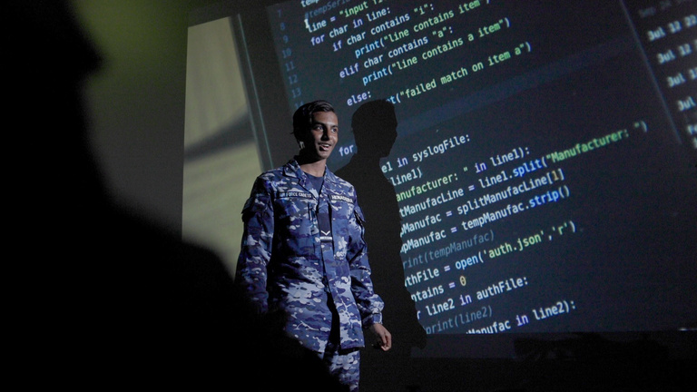
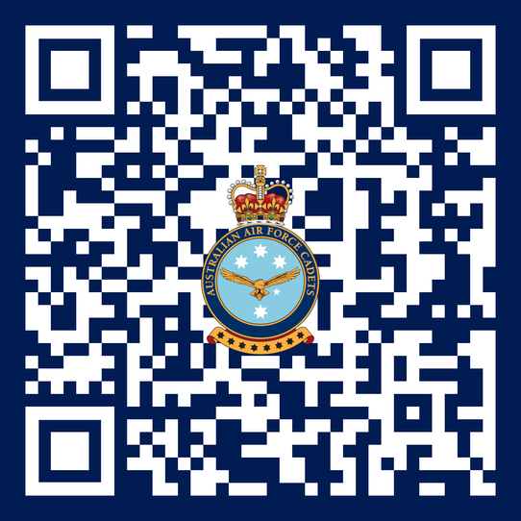
airforcecadets.gov.au/our-future

Slide 34
Questions?
Connect with us

